Slide 1



VSSE
PRESENTATION
Presentation can be sent to the client in PDF-format after the meeting if desired.
Notes:
Hello! I hope everyone can hear me and see the presentation.
My name is William and I welcome you all to VSSE 2020 and Company 1's presentation.

Slide 2
Agenda
1
About us
2
Our solution
3
Adressed Problems
4
Demo
5
Future Development
6
Wrap-up
Notes:
Today we will quickly tell you about our company, our solution, the problems adressed, future development and give you a demonstration of the current implementation.

Slide 3



Presenters
About us – Presenters
William Bergekrans
Lead analyst
Victor Lindholm
Lead developer
Albin Jonfelt
Developer & integrator
Notes:
As I said my name is William and I will be joined today by Victor and Albin that will give you a product demonstration.

Slide 4



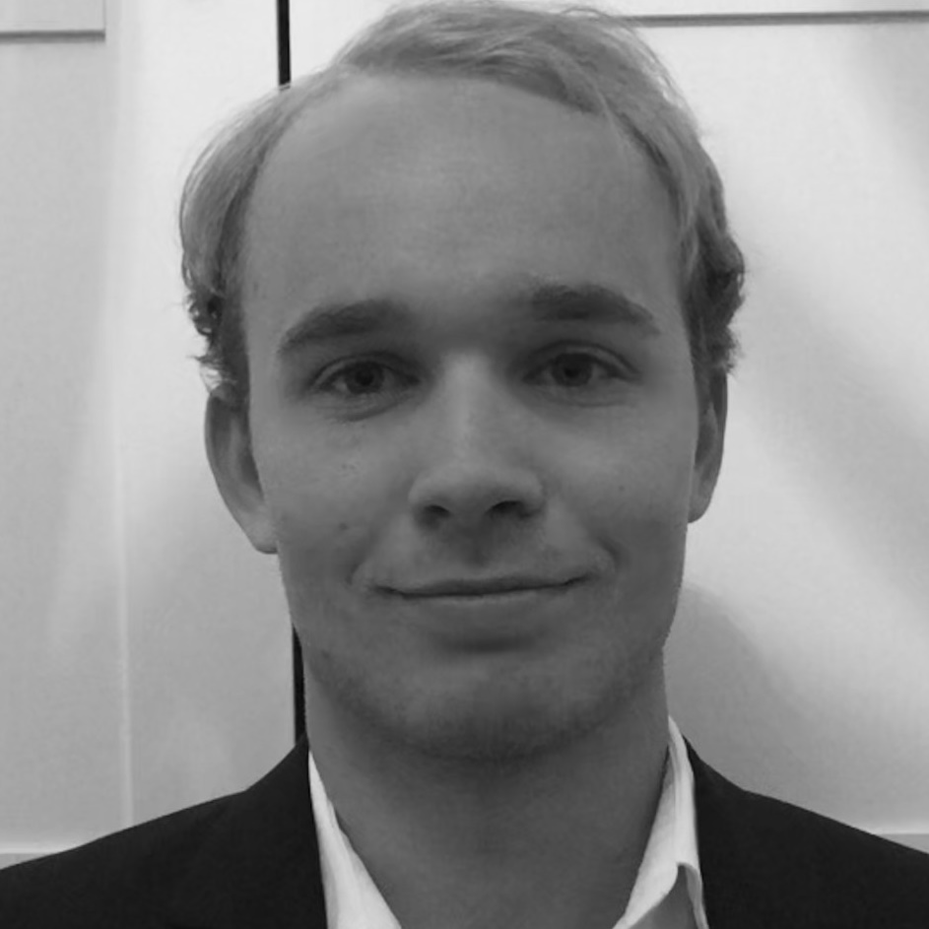
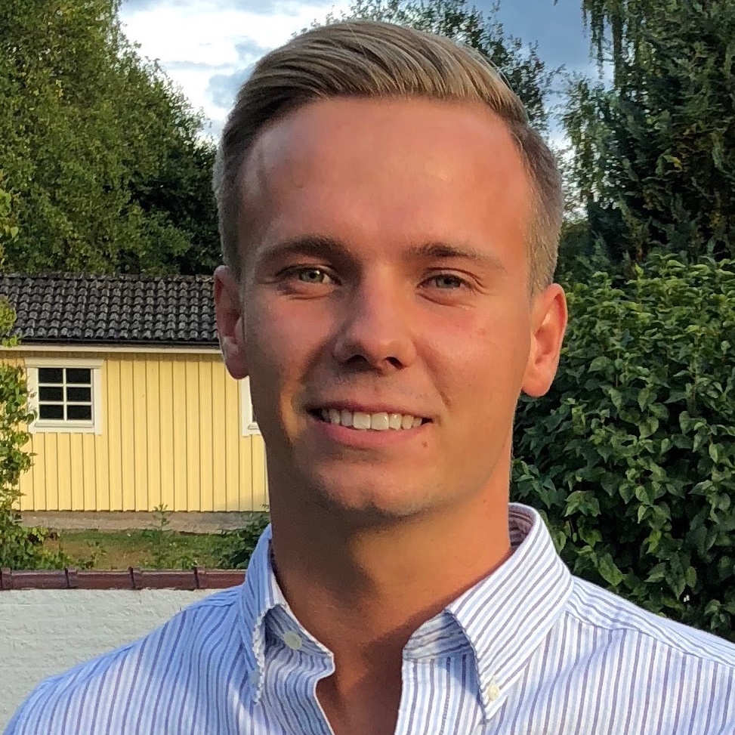

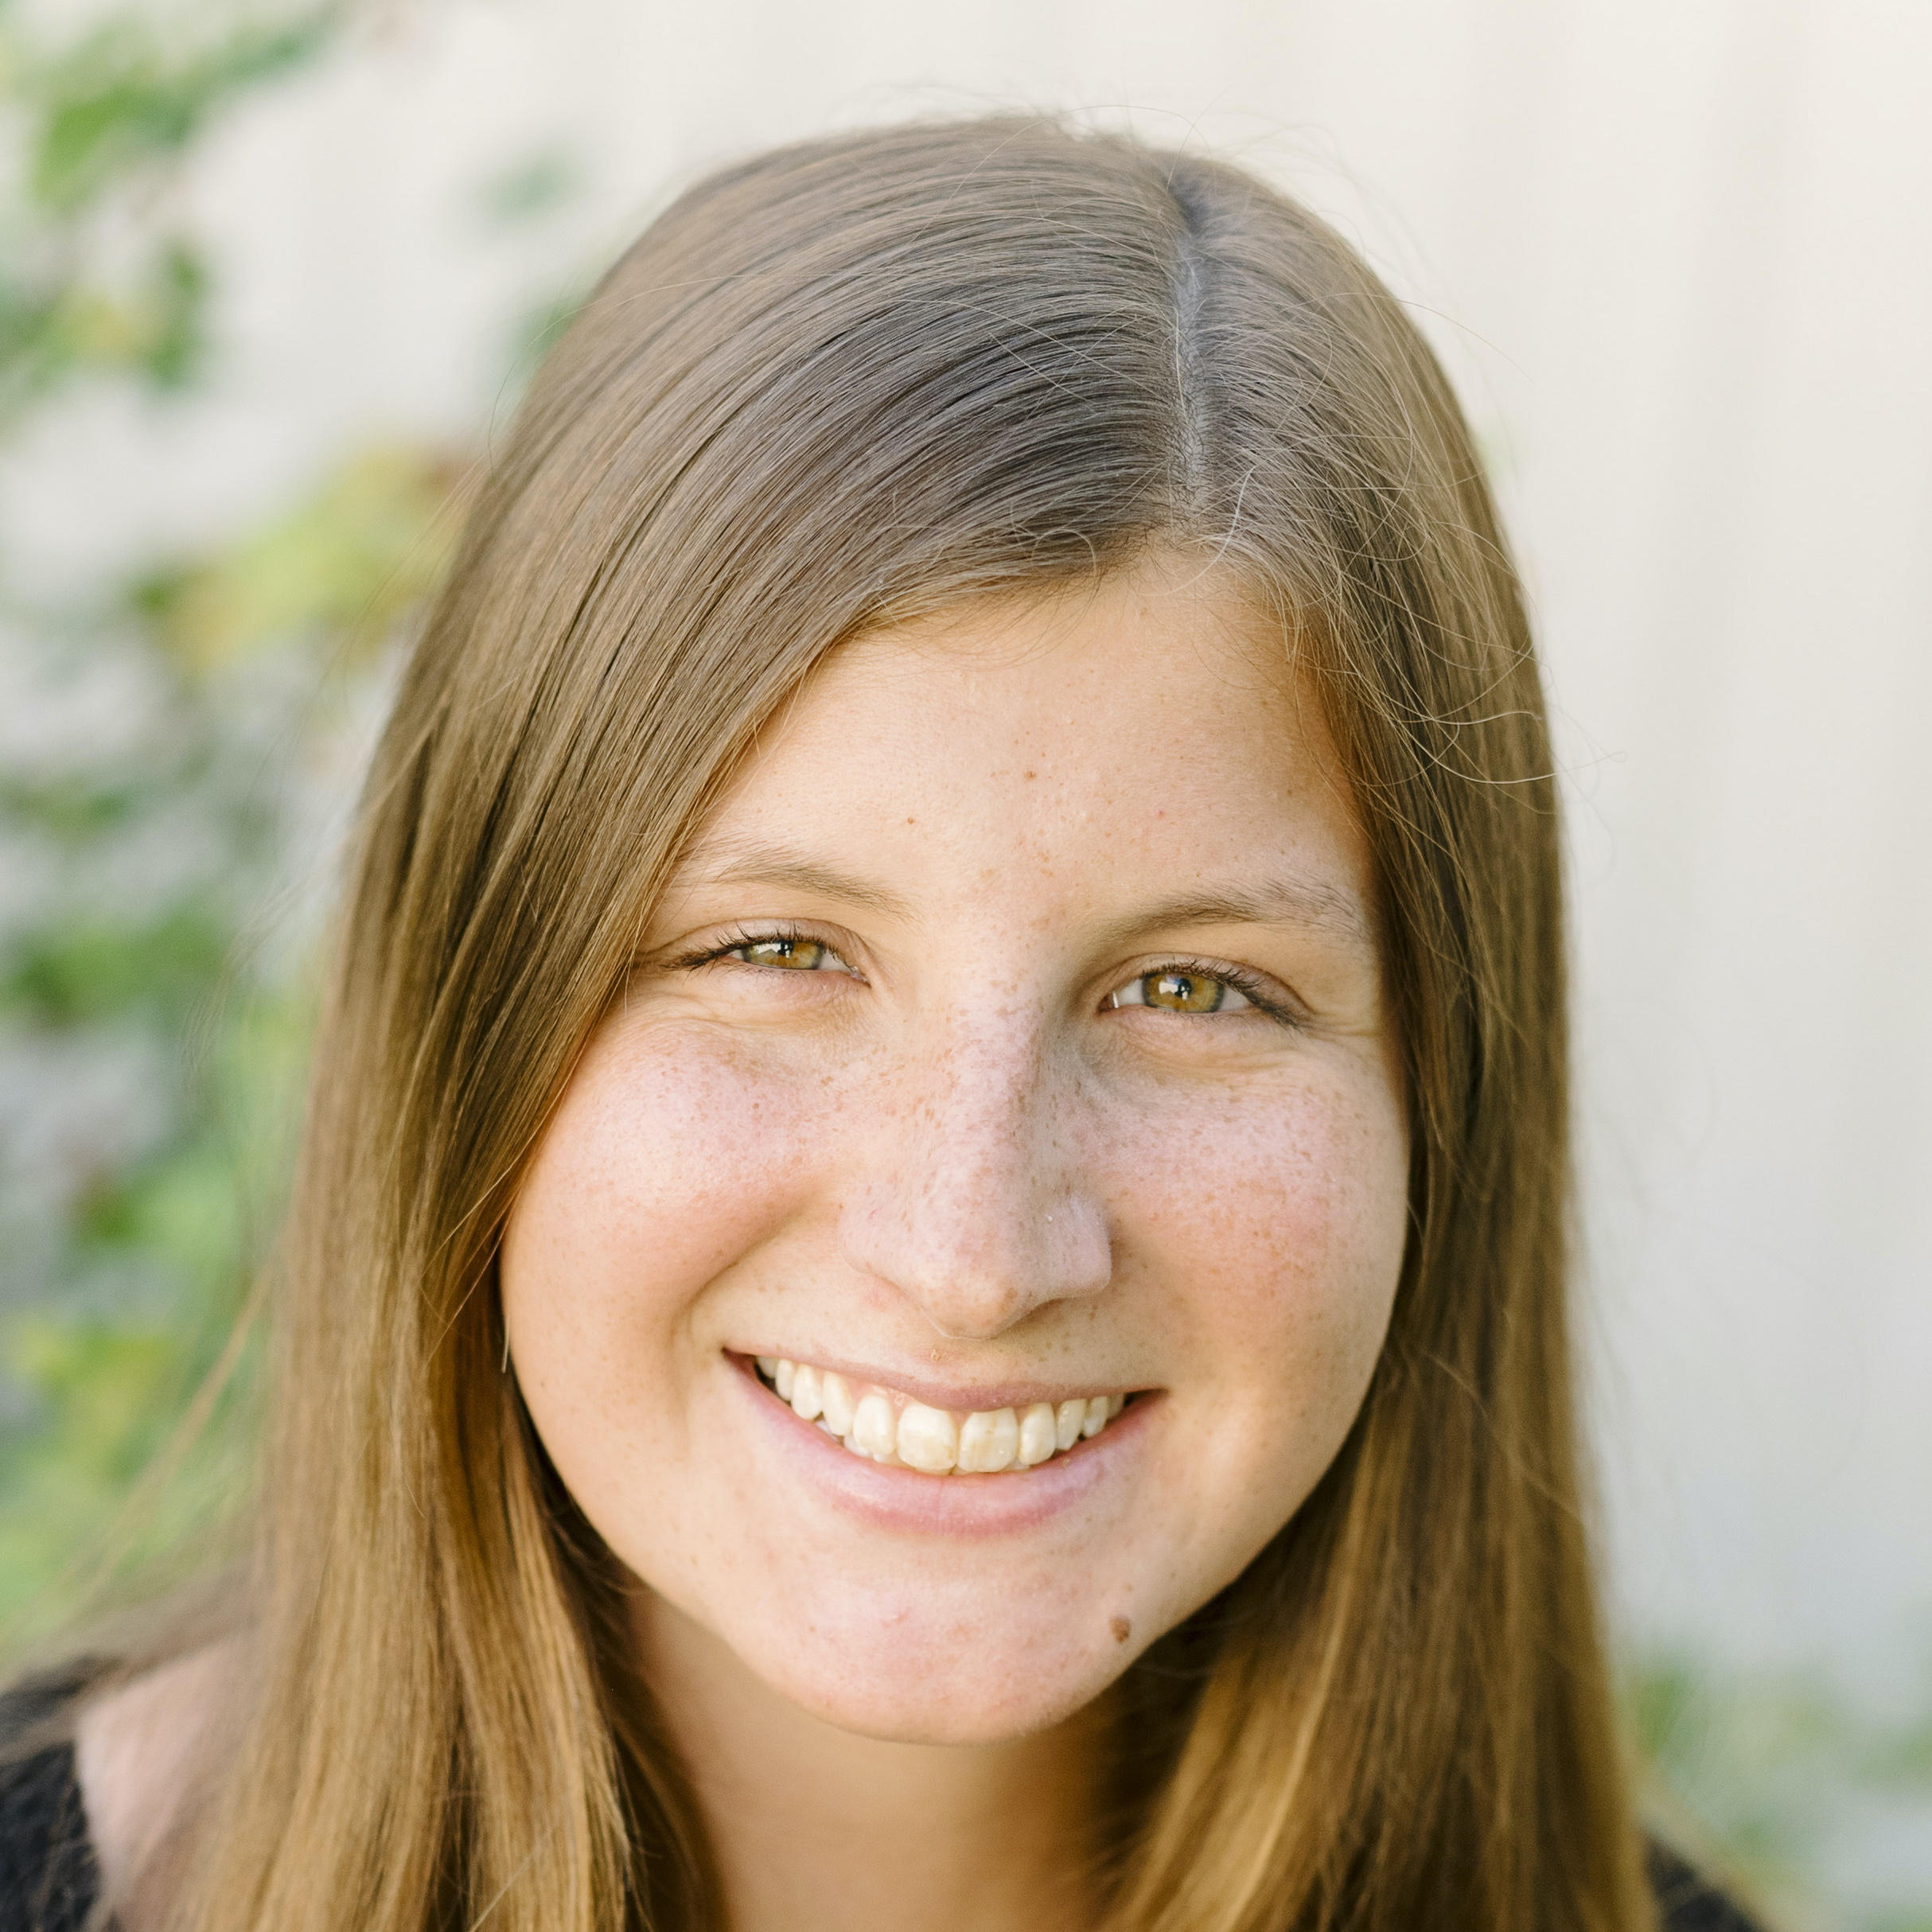





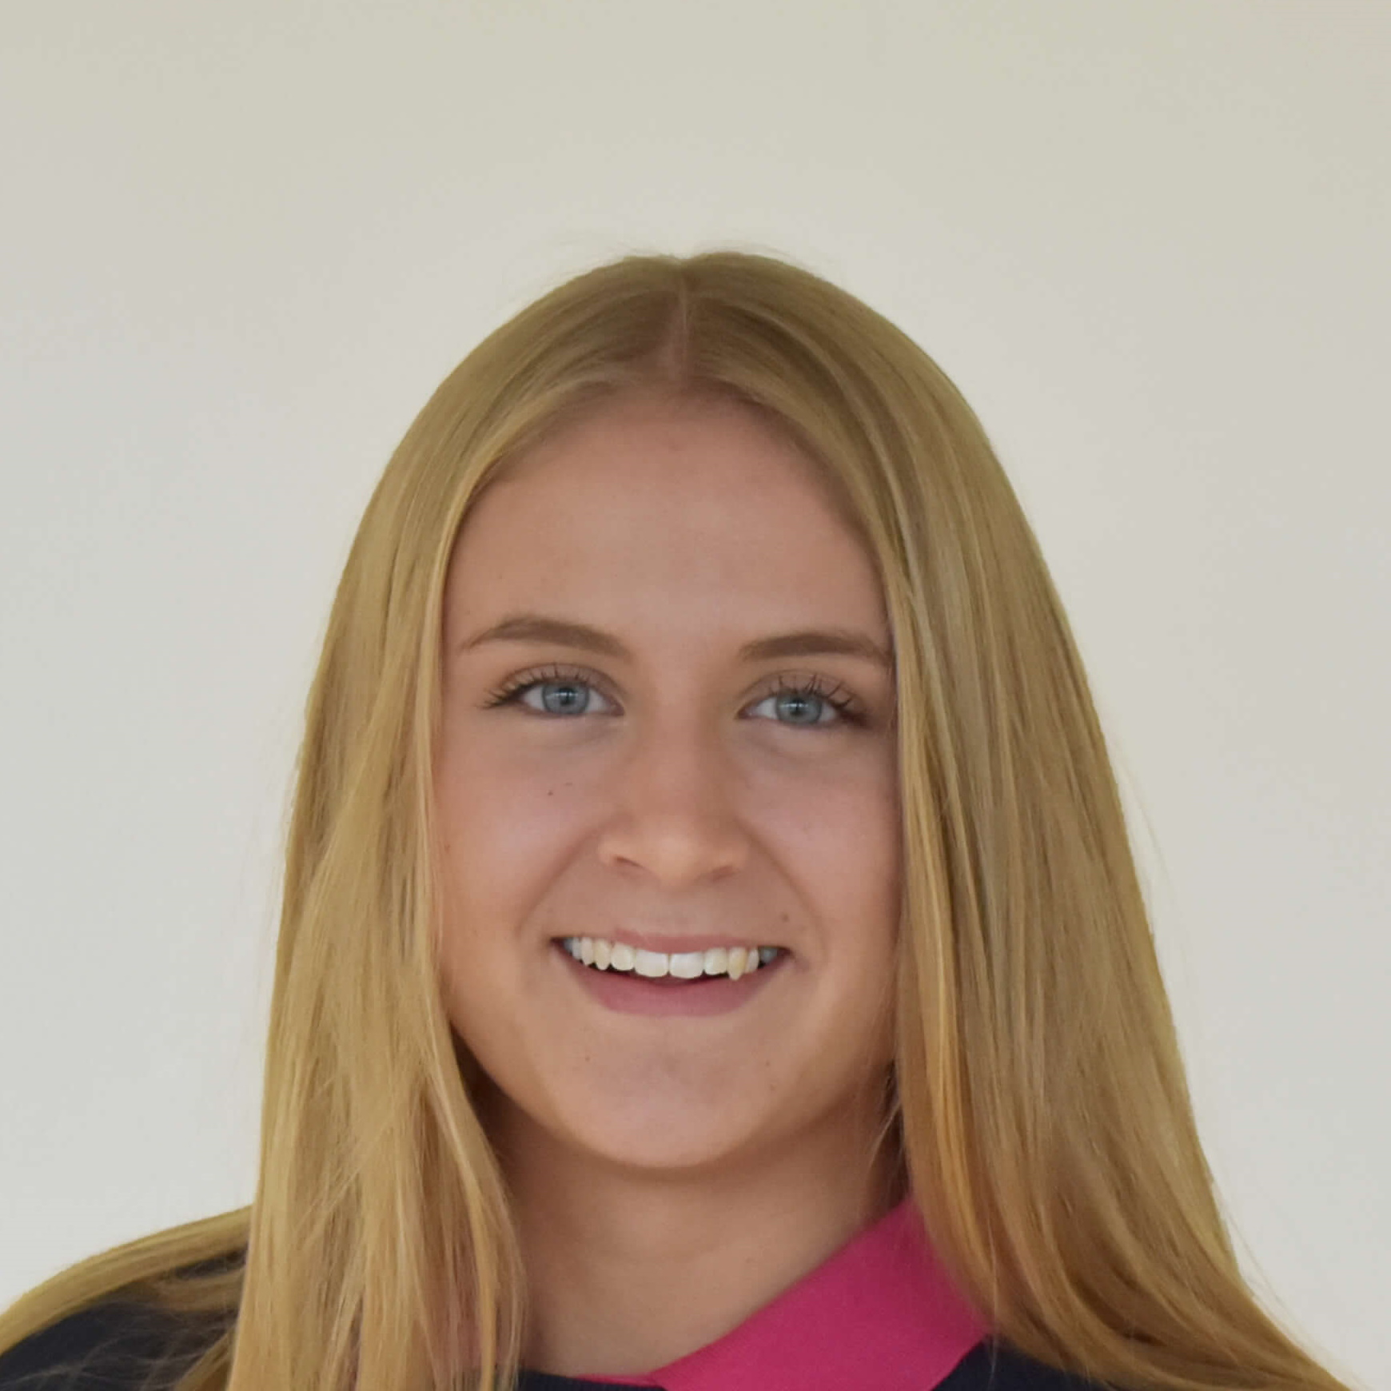








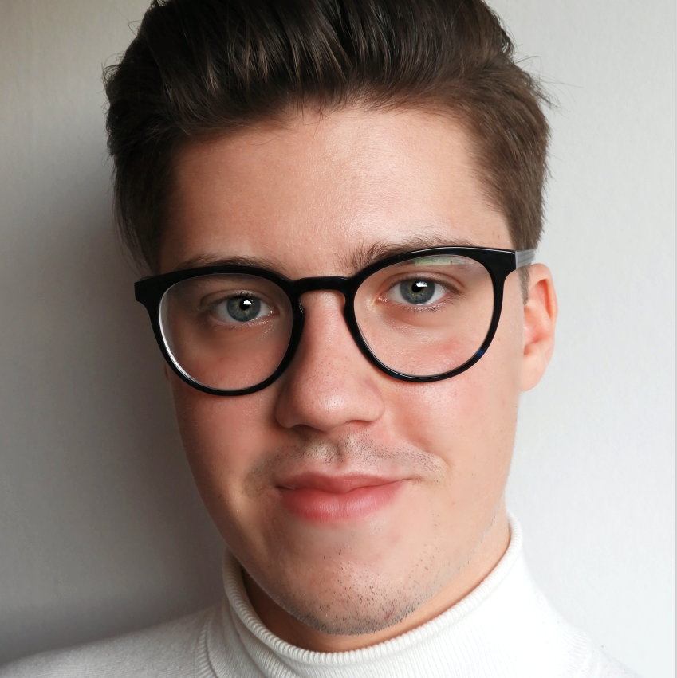
Number One Company
About us – Number One Company
Newly started company
24 employees with broad set of competencies
Developed Rostbot
Notes:
We are of course part of a bigger company consisting of 24 employees. We're divided into two major departments, Research and development and product and sales led by a management dep. Together we have developed RostBot.

Slide 5

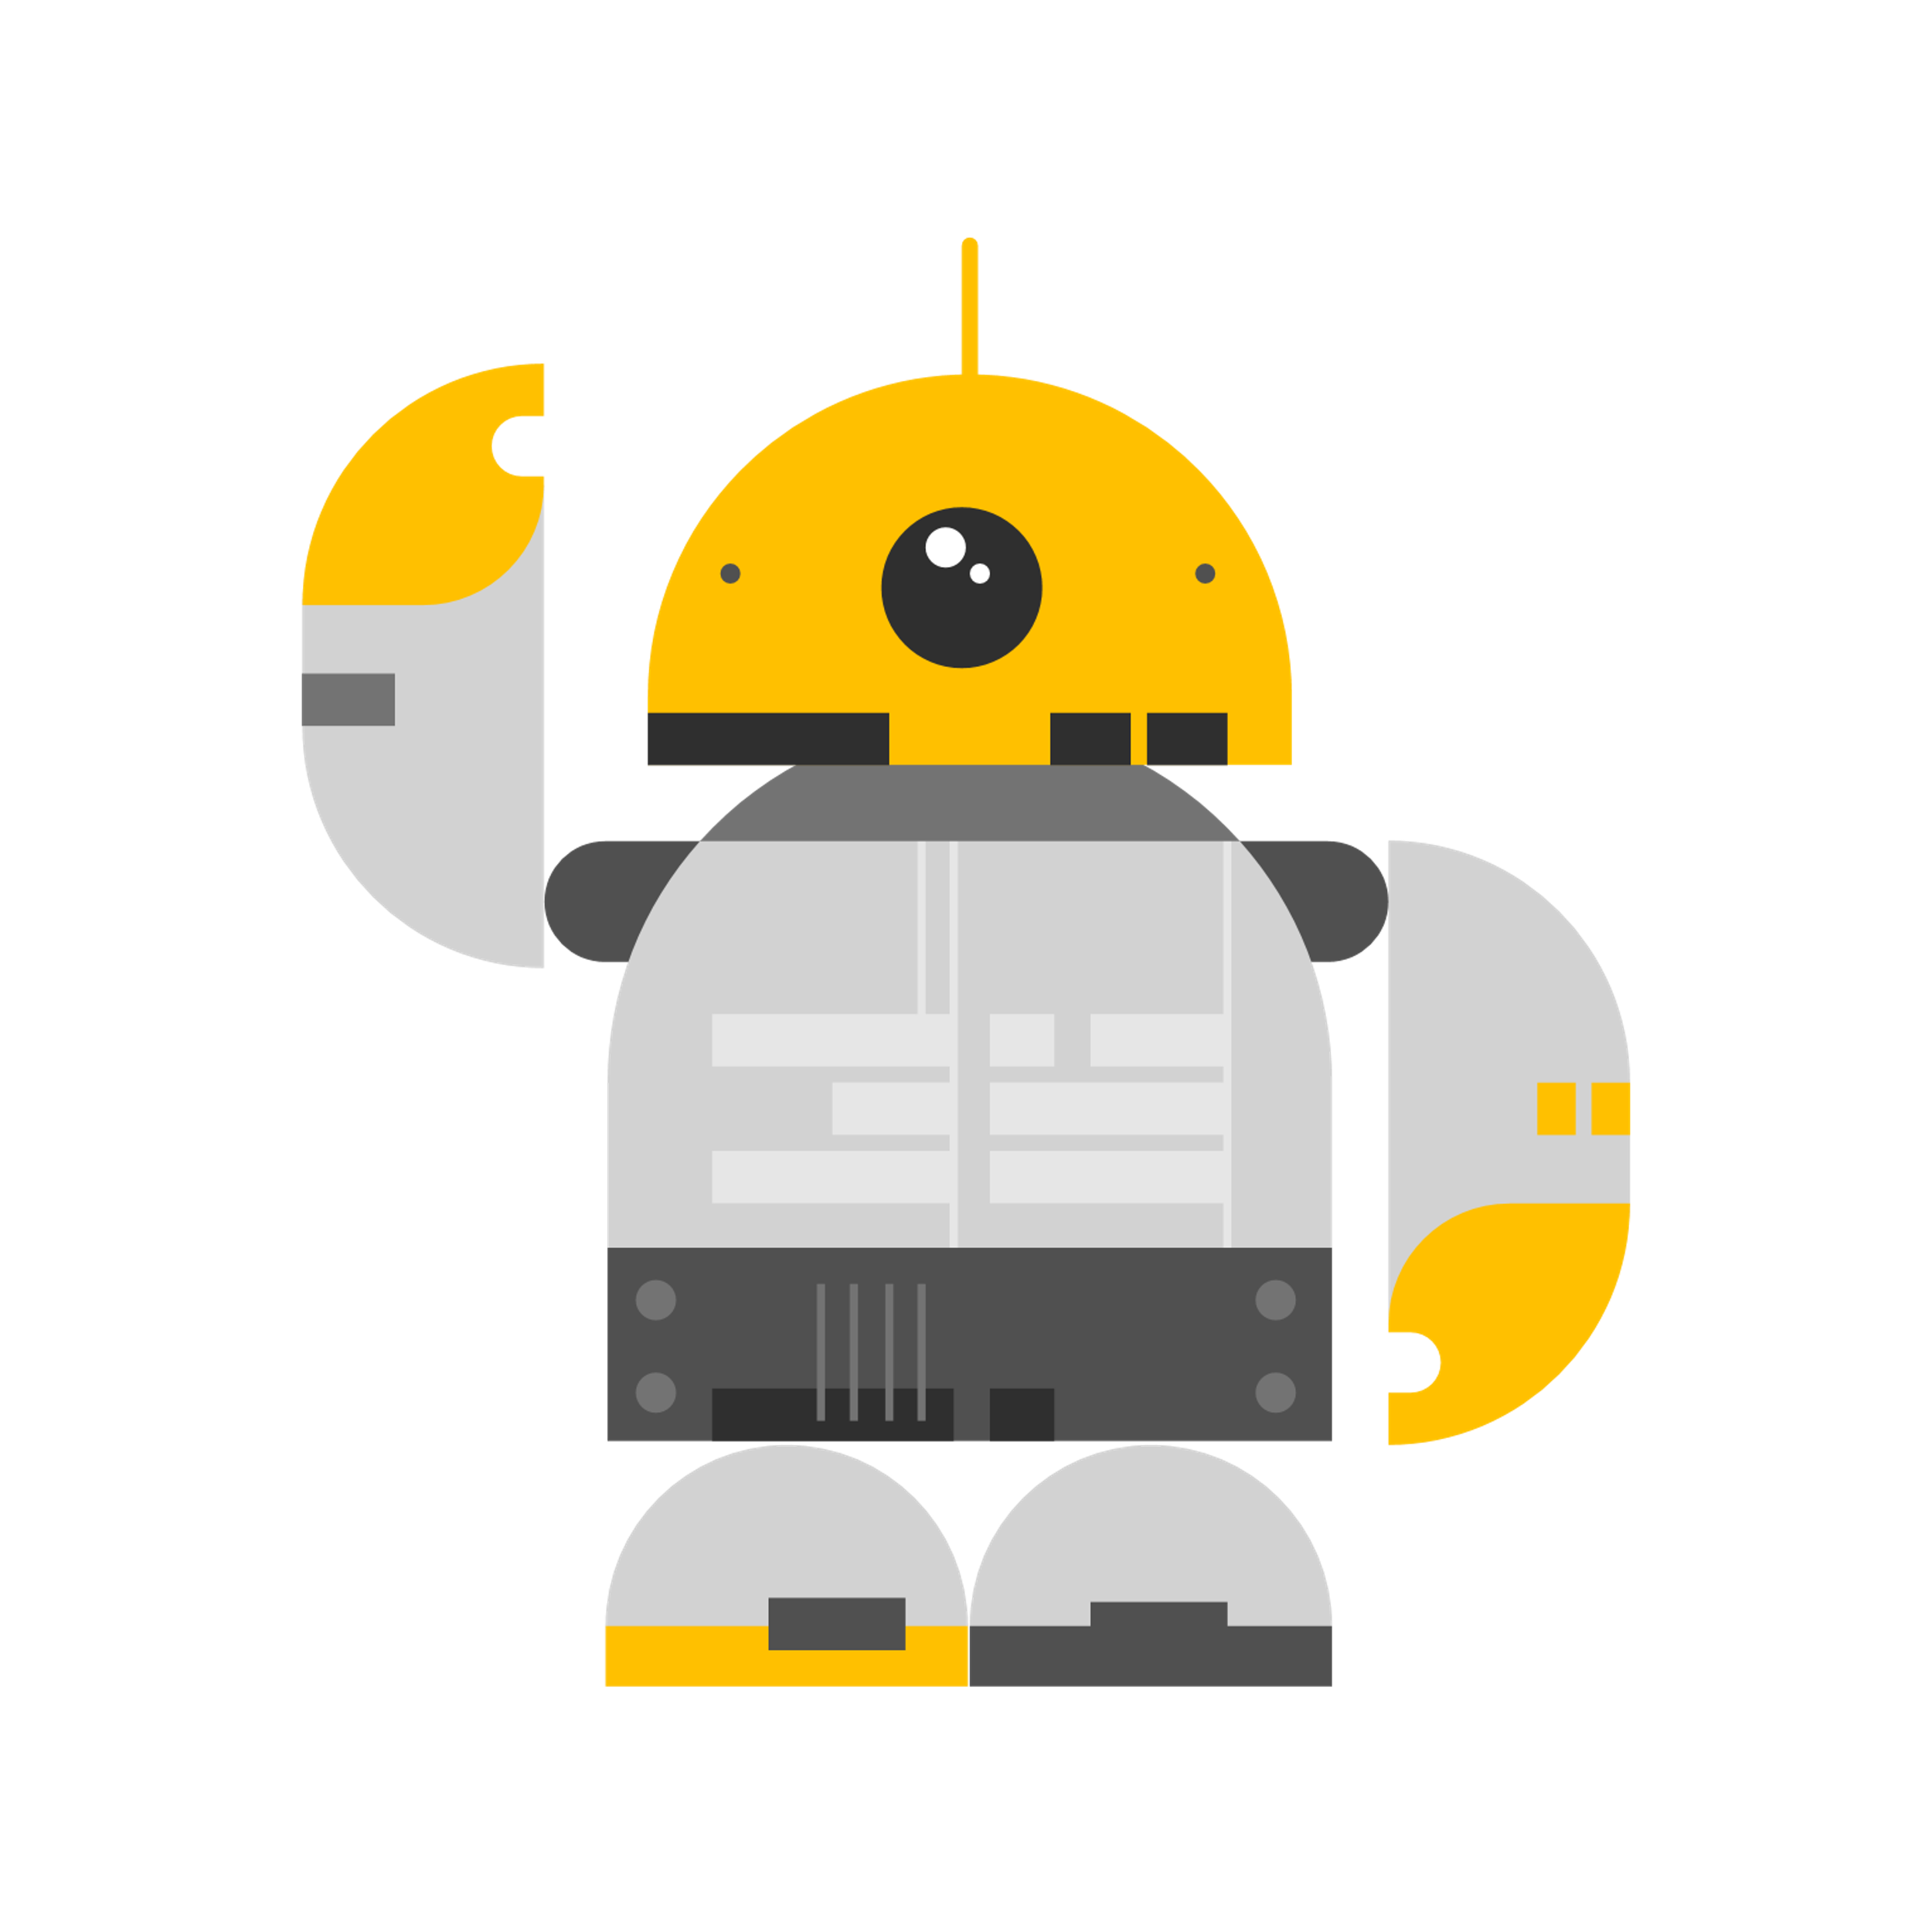



Problems
...how do we solve these problems?
Manage many patients simultaneously
Continuous Measuring
Trust & Familiarity towards the system
Notes:
Self-monitoring is not easy to do and it requires the patient to invest resources (time) into it, which not everyone is inclined to do. We wanted to find a solution that makes the
The problems we identified with the home monitoring system today is:
How to make sure the patients continue to perform their measurements over a long period of time.
How to maintain trust and familiarity towards the system when it is completely digitalized.
How to relieve the caregivers amount of workload and manage to help more patients simultaneously.
So.... how do we solve these problems?

Slide 6

RostBot
Region Östergötlands Chat Bot
Notes:
ROSTBOT .
Region Östergötlands chat bot. A chatbot for the patients to get a smoother experience when being part of a self-monitoring service.

Slide 7


Our solution is
Wherever you need it, whenever you need it-
Always available.
Notes:
So long as you have access to the internet, you will have access to Rostbot, whether it be from the beaches of varamon to you cabin in Åre. When the telephone que is 1 hour and in the middle of the night.

Slide 8


User interfaces
Website
Microsoft Teams
Notes:
The bot can be implemented on practiacally any platform. The current bot is developed using Microsoft’s bot framework which has med web and Teams implementation easy. The bot is available now in a webb interface and on Microsoft Team. There is a big argument for implementing the chatbot in Facebook’s messenger as this plattform is the most videly used social media, especially among older generations.

Slide 9



Our solution
Questionnaires
Get information
Take measurements
Book appointments
Notes:
Out bot allows the patient to carry out daily tasks and get information about her own health status and answers to general questions. RostBot lets you interact with your healthcare services in a new way, whether it be booking appointments, searching for information, taking measurements or filling out questionnaires. They’re all available through our RostBot.

Slide 10


No waiting in phone queues
Our bot lets you book appointments directly from the chat interface!
Need to fill out a questionnaire?
Fill them out wherever you are, no paper required!
Notes:
Scenario: You’ve had a cough and are feeling feverish. You’re sluggish but you feel like you need to talk to someone, but it’s 8:30 am and you know from experience that the phone times to Vårdcentralen Ryd are all booked. So you take up your phone and ask RostBot what you should do. He/She/They asks for your symptoms and you describe them, RostBot thinks you should see a doctor. Rostbot shows you the earliest available times at your vårdcentral and you select one that fits your schedule best. No waiting by the phone, no sitting in queues. You might be feeling depressed, so you have to fill out a questionnaire about your mental health. So you grab your phone or tablet, go to a place where *you* feel safe and comfortable, and RostBot asks the questions. No papers, no website navigation.

Slide 11





Need help?
RostBot helps you take measurements correctly and can help you find the information you need.
Notes:
RostBot has the ability to help users with using measurement devices, using pictures and describing what to do each step of the process, so you wont have to feel like you’re making a mistake.
If you’re just out for some general information, you’ve the ability to simply ask. If RostBot can’t answer, He/She/It will send you links to pages that have the information you need.

Slide 12
Made to integrate and grow
Developed with mindset of future customization.
openEHR integration.
Easy to update guides, schedules, and more through a database.
Notes:
RostBot has the ability to help users with using measurement devices, using pictures and describing what to do each step of the process, so you wont have to feel like you’re making a mistake.
If you’re just out for some general information, you’ve the ability to simply ask. If RostBot can’t answer, He/She/It will send you links to pages that have the information you need.

Slide 13



Continuous Measuring?
All functionality is concentrated within the chat!
No need to navigate around → easier to use and understand
Better attitude towards the system
Continuous Measuring!
System is used more frequently by the patients
Notes:
Regarding continuous measuring we believe our solution copes with this... Firstly, this solution concentrates all functionality within the chat --> which implies that the patients no longer need to navigate around on the application for every single purpose which makes this solution easier to use and easier to understand. --> This generates a better attitude towards the system --> which will increase the possibility of using the system efficiently --> and therefore the patients will continue to perform their measurements.

Slide 14





Trust & familiarity towards the system?
More personalized conversations
Improved service and user experience
Trust & Familiarity!
“Increased human interaction”
Less lack of face-to-face contact
Notes:
When it comes to trust and familiarity towards the system we believe this solution increases the feeling of "human interaction" as the chatbot is intended to generate a more realistic experience of personal contact as the conversations also shall be adapted to each patient in order to personalize the conversations. We believe this can improve the lack of face to face contact the home monitoring system provides today --> which will improve the overall service and user experience --> and therefore improve the trust and familiarity towards the system.

Slide 15



Manage many patients simultaneously?
Bot answers questions from the patients
Less questions to the caregivers
Decreased workload
The caregivers get more time over for other patients → Manage more patients simultaneously!
Bot checks the patient’s symptoms
Less calls to the caregivers
Notes:
When it comes to manage many patients simultaneously we believe there are two important contributors:
Firstly, we believe that the chatbot will have an impact on the number of questions asked by the patients as the chatbot are able to answers questions in the chat. --> This will generate less questions in total towards the caregivers. --> which will decrease their workload that in turn can be spent in other more important activities – and therefore be able to handle more patients simultaneously as some get answers from the chatbot instead.
Secondly, this solution also allows the patients to check their symptoms and clarify the severity of them. If the symptoms are considered bad enough, the patient will be able to book a consultation through the chat. This will decrease the amount of phone calls from patients that have questions about their symptoms, and therefore also help the caregivers monitor more patients simultaneously.

Slide 16
Demo

Slide 17




Future Development
Trend analysis
Smart home integration
Image recognition
Natural language processing
Notes:
RostBot is still a child. We see high potential for the chatbot and it can be well integrated with other, already existing solutions. Using image recognition to automatically read and save the values of a user-submitted image of the measurement device, making the bot available on smart home devices, and leveraging the data the bot collects to make predictions on the patient’s condition are three improvements that we think would improve the user experience greatly.

Slide 18
RostBot
Region Östergötlands Chat Bot

Slide 19
Thank you!
Notes:
That’s it for our showcase of Rostbot. Thank you all for listening! Does anyone have a question? ☺

